Slide 1

P69 : AI Chatbot
Group no. 5
Shriniwas Deshmukh, Amruta Kumbar,
Shruti Pandey, Sadhana Nemani, Sonu Dabhade
Mentored By
Shreenath (EXCELR)
04/09/21

Slide 2
Business Problem
Unavailability of chat option to get your data science interview questions with your answers, for a one stop solution on your seeking Data Science interview answers for your questions.
Project Objective
To create a Chat bot to provide a seamless response to Data Science interview questions with an appropriate answer, by mining from the web.

Slide 3
What is a Chat Bot?
A chatbot is a software application used to conduct an online chat conversation via text or text-to-speech, in lieu of providing direct contact with a live human agent
Designed to convincingly simulate the way a human would behave as a conversational partner
A chatbot is programmed to work independently from a human operator. It can answer questions formulated to it in natural language and respond like a real person

Slide 4
Project Architecture / Project Flow
Develop Database
Exploratory Data Analysis and Feature Extraction
Web Scrape Data
( json file format)
Load json Database into Model
NLP text pre-processing Stemming & BOW
Model Deployment
Model Development, Training and Testing
using Python
Live Chatbot using
Streamlit or Flask
Load Chatbot Model and Make Predictions
Develop a Neural Network Model
Train and save

Slide 5
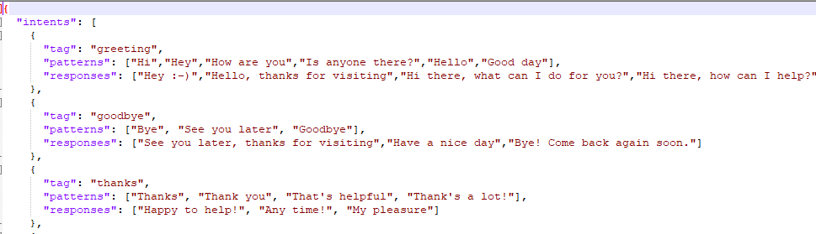
Develop Database
Web Scrap the data from different websites and different URLs using BeautifulSoup library in python
Multiple websites have a lot of information about data science interview questions and answers like Analytics vidhya, Wisdom jobs, guru99 etc.
Build the database of interview q&a in json file format

Slide 6
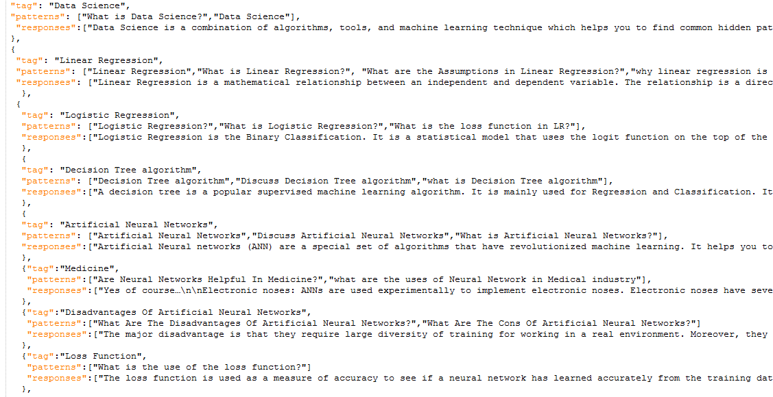
Database Overview

Slide 7
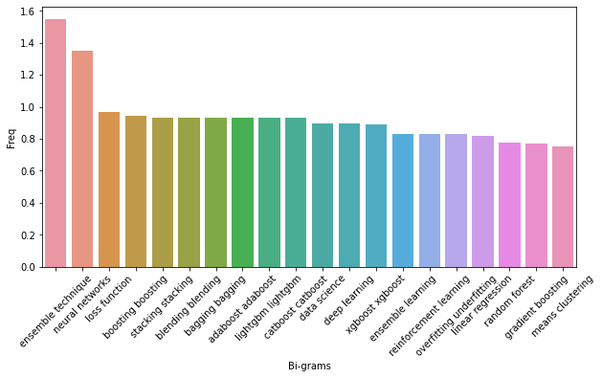
EDA & Feature Extraction

Slide 8
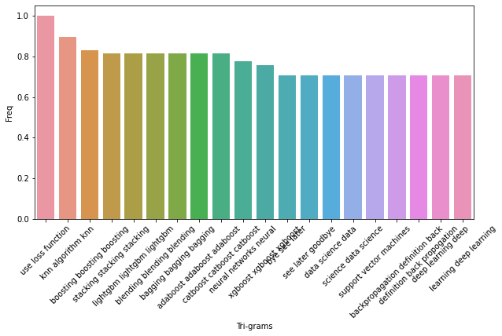
EDA & Feature Extraction

Slide 9
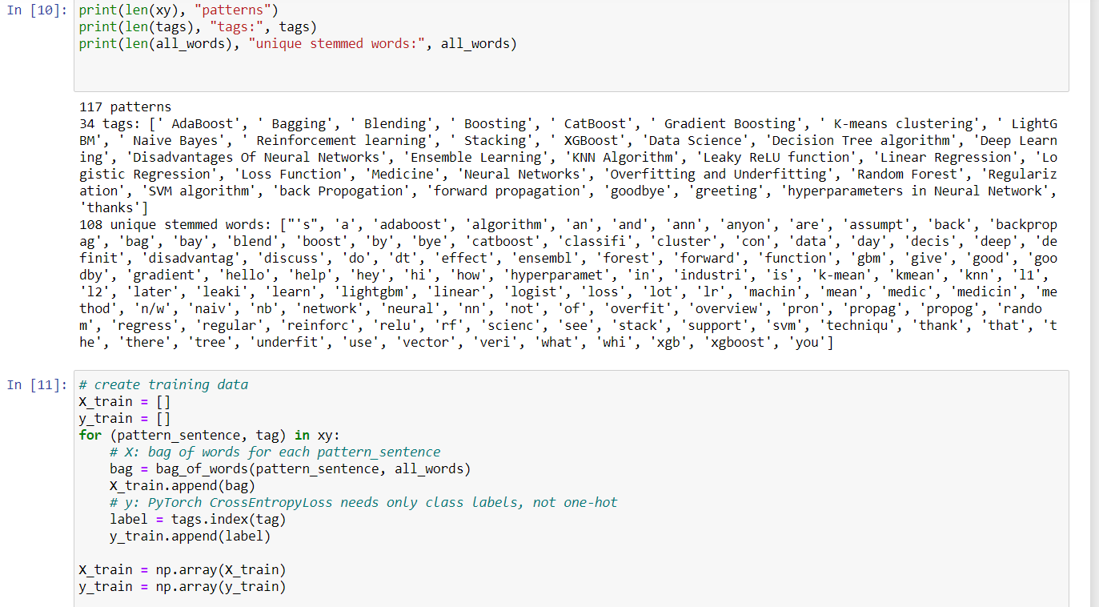

Slide 10
Feature Engineering
Word Stemming:
Stemming a word is attempting to find the root of the word after normalization. It reduces the vocabulary of the model and attempts to find more general meaning behind the sentence.
Bag Of Words:
BOW represents each sentence with a list i.e. the length of the amount of words in our models vocabulary. Each position in the list will represent a word from our vocabulary. If the position in the list is a 1 then that will mean that the word exists in our sentence, if it is a 0 then the word is not present.

Slide 11
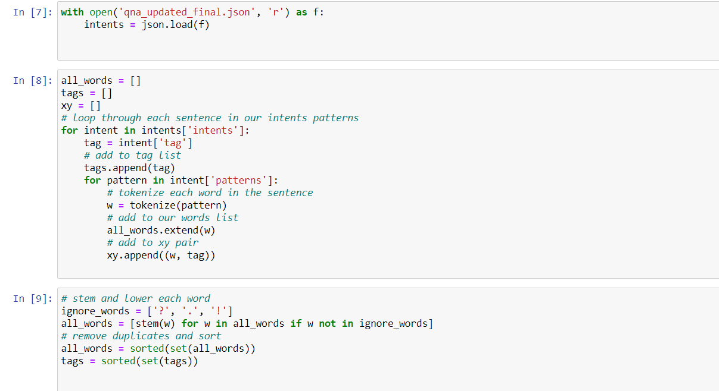
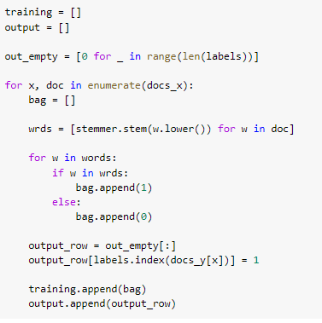
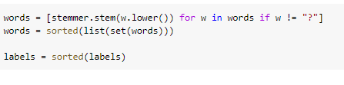
Stemming and BOW

Slide 12
Model Development
Model development uses fairly standard feed-forward neural network with two hidden layers. The goal of our network will be to look at a bag of words and give a class that they belong to (one of our tags from the JSON file)
The model built is trained using json database and saved.
Next comes, loading the same model and making predictions

Slide 13
Model Prediction
Chatbot shall generate a response to any sentence the user types in.
It does not take string inputs but uses BOW list.
It does not split out sentences but generates a list of probabilities for all of our classes like – Get some input from the user – Convert it to a bag of words – Get a prediction from the model – Find the most probable class – Pick a response from that class.

Slide 14
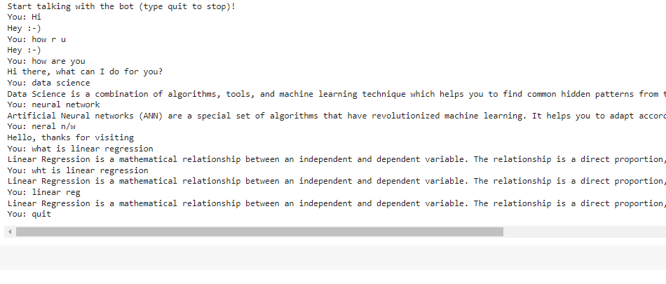
Chatbot Overview

Slide 15
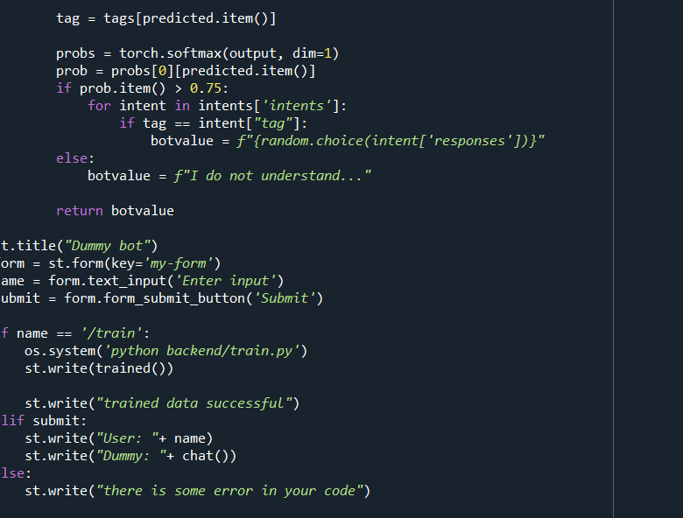
DEPLOYMENT: Streamlit code

Slide 16
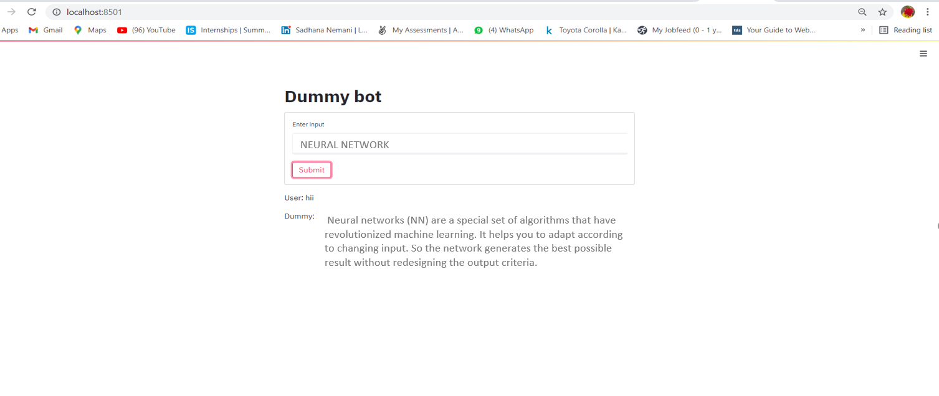
Model Deployment
Streamlit

Slide 17
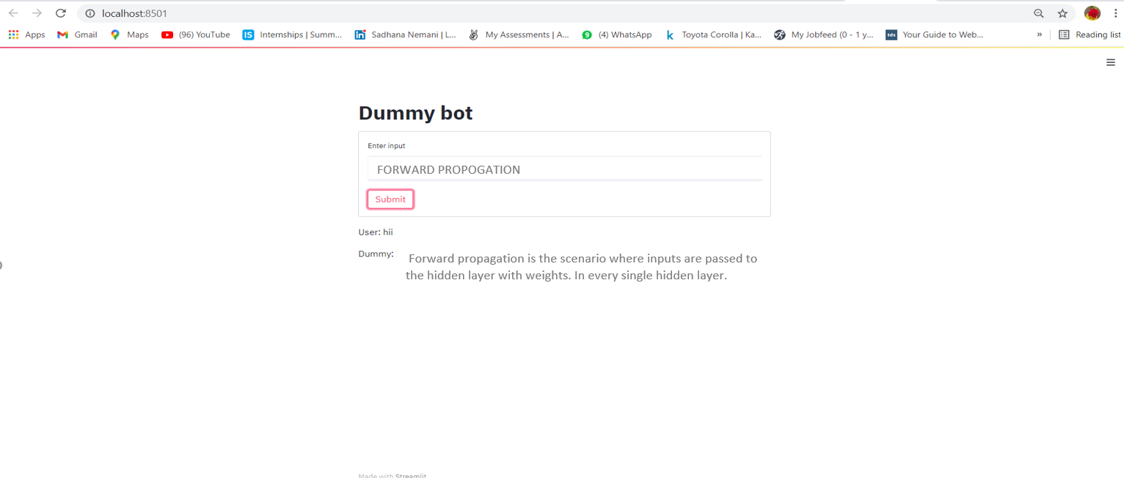
Model Deployment
Streamlit

Slide 18
Thank you

